Slide 1
EEG Data Acquisition and Analysis
Health Technologies 2022 – 2023
By Rosa Lucia Capurso, Mario Caruso, Tesfay Fisheye, Luigi Loiacono, Michele Morelli

Slide 2

Introduction
In the present work we have used an EEG acquisition system to collect data from 7 subjects with age ranging from 20 to 30 years
3 different scenarios were presented to each subject by means of a VR device
The collected EEG signals were filtered and processed in order to perform a Power Spectrum Analysis (PSA) and a Connectome Analysis

Slide 3
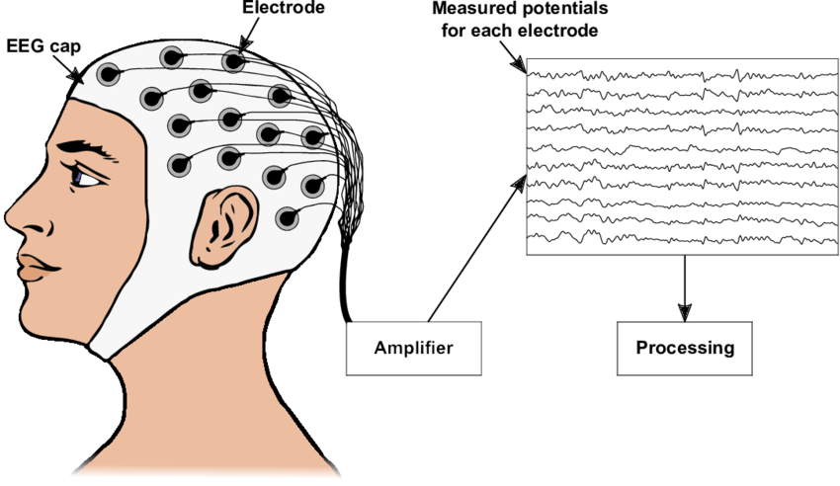
The Electroencephalogram
EEG is a non-invasive technique that measures electrical activity in the brain using small electrodes attached to the scalp. Brain cells communicate via electrical impulses. This activity shows up as wavy lines on an EEG recording
An EEG is one of the main diagnostic tests for epilepsy and other brain disorders
Fig. 1 – EEG acquisition scheme.

Slide 4
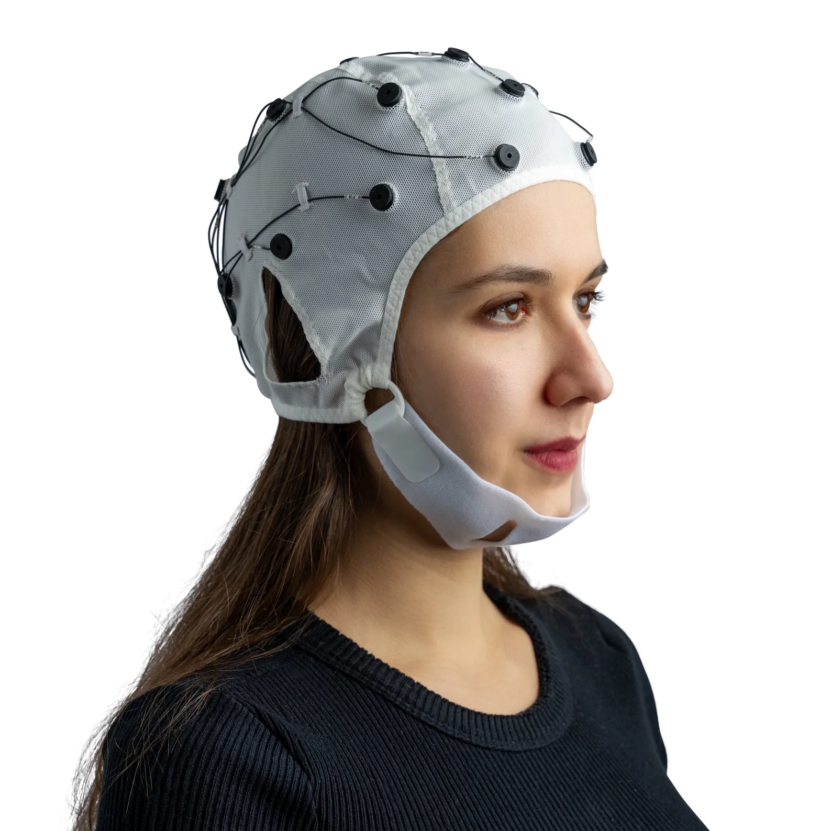

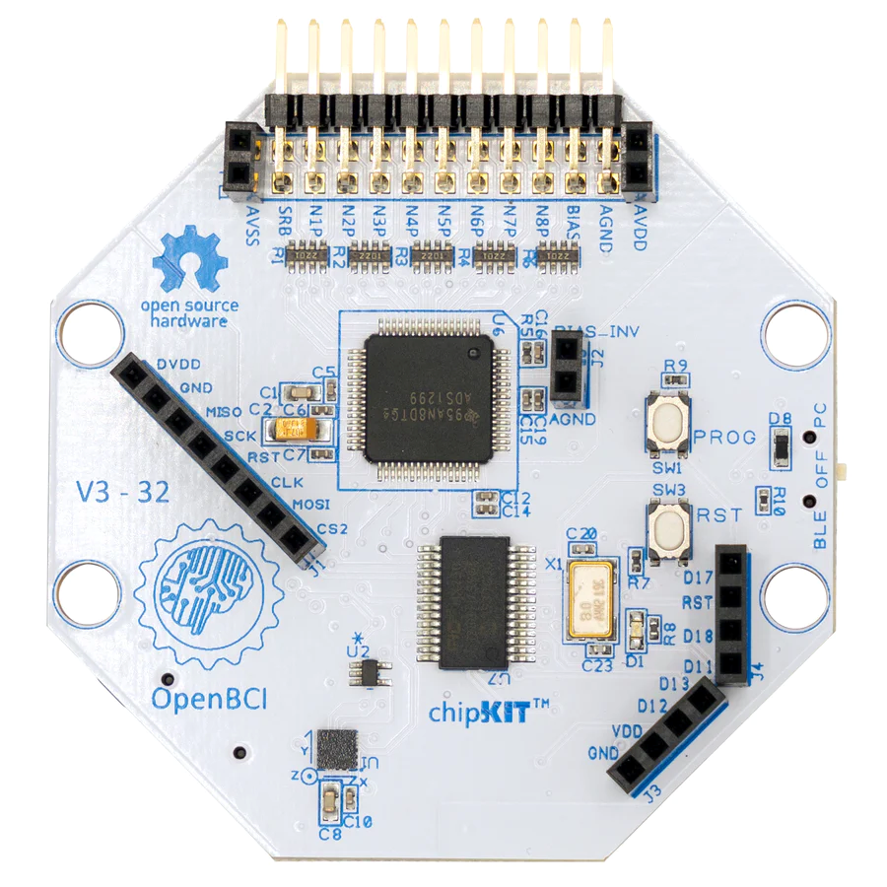
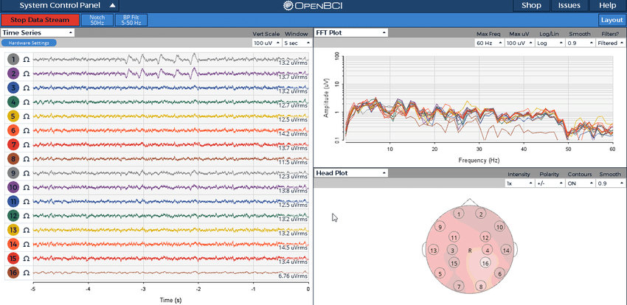
The Experimental Setup
(1) Electrode - cap
(2) Oculus Rift VR
(3) Cython Board
(4) OpenBCI software

Slide 5



Data Acquisition Procedure
“Rest” Phase (3 min)
“Snow” Phase (7 min)
“Urban” Phase (3 min)

Slide 6

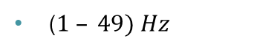
Data Analysis: Pre-processing
Bandpass Filter
Re-referencing
($1 – 49) Hz$
$x_{i}\left(t\right)−\overline{x(t)}$
Channels removal
ICA
Flat channels
Signal to noise ratio
Fast ICA for artifacts removal

Slide 7
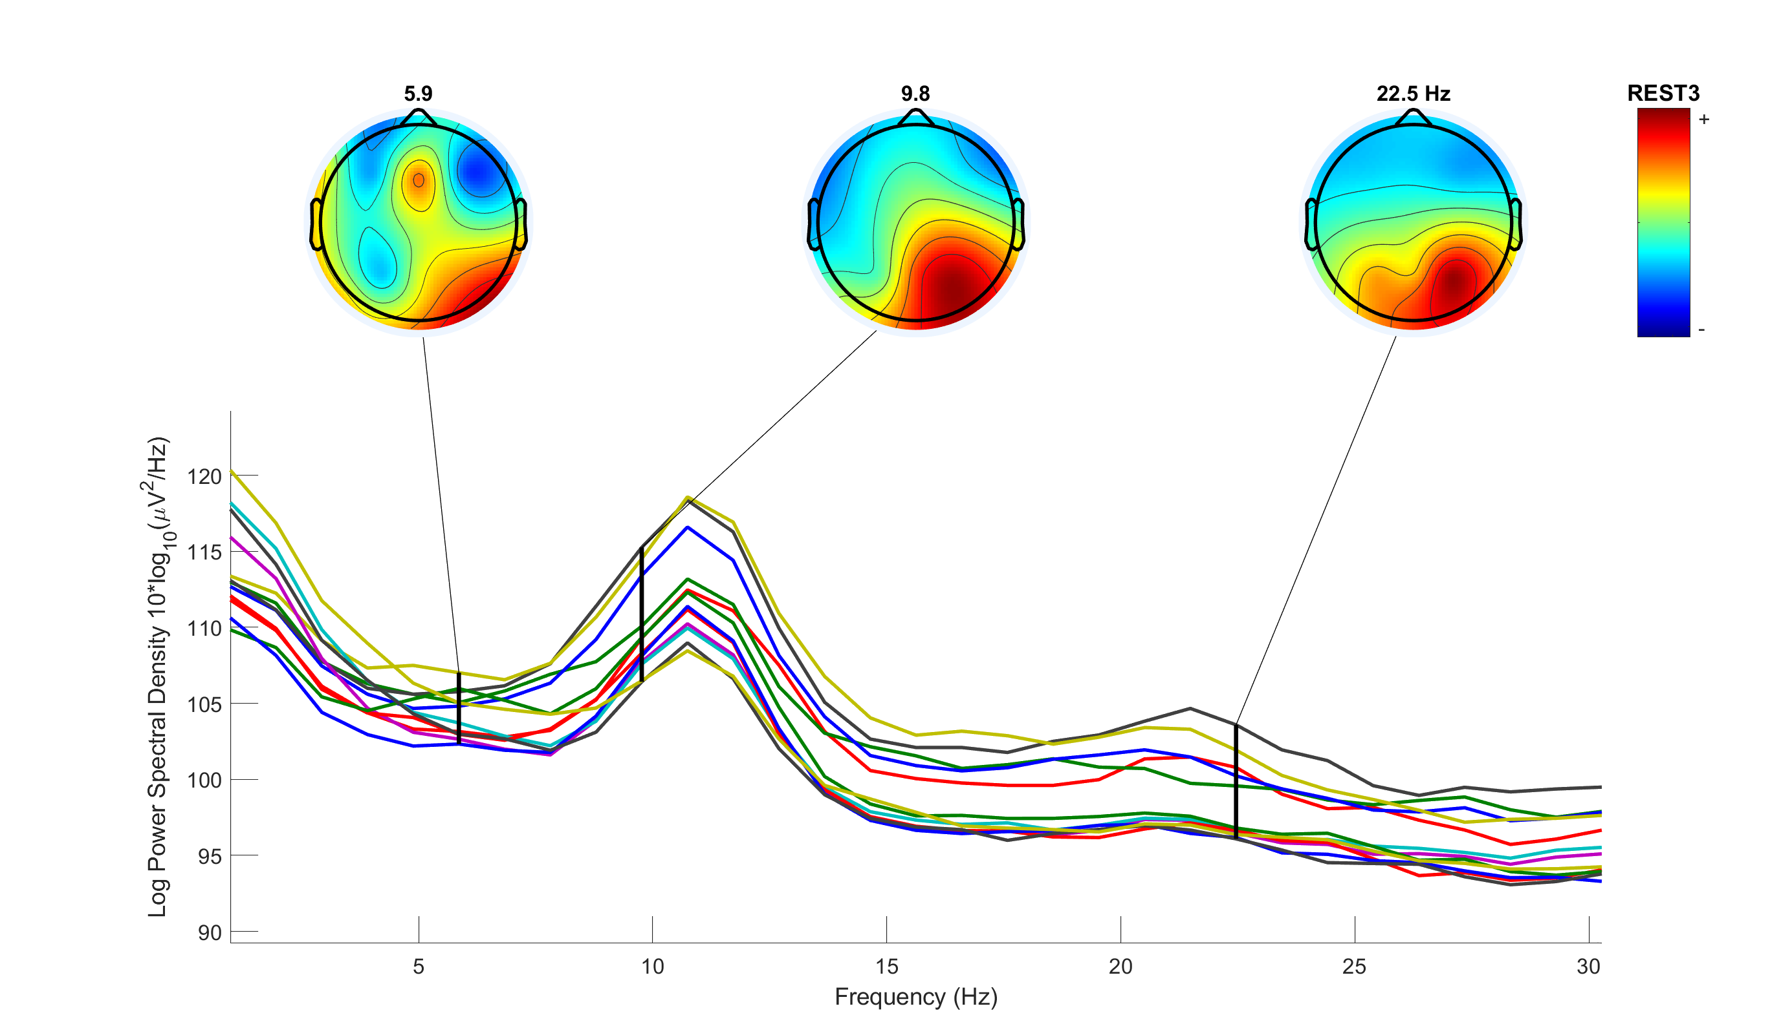
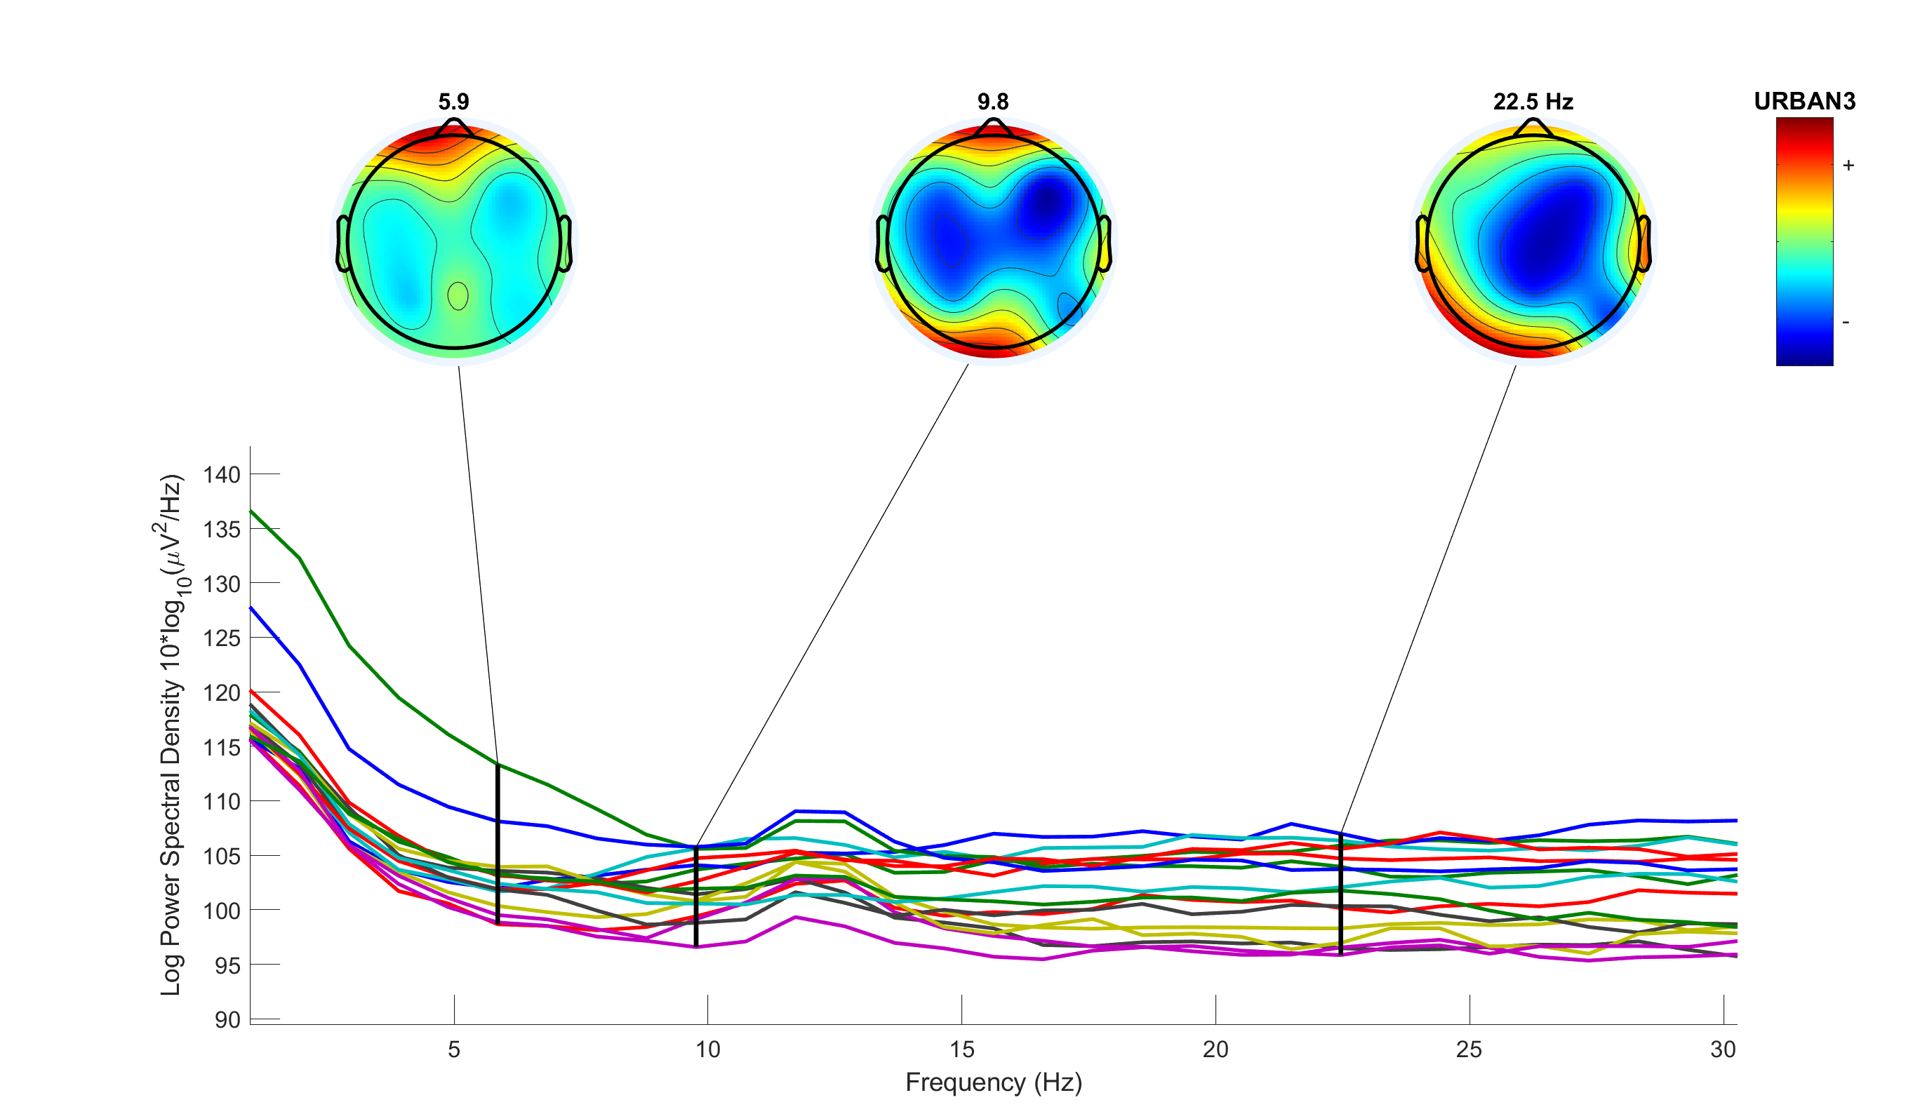
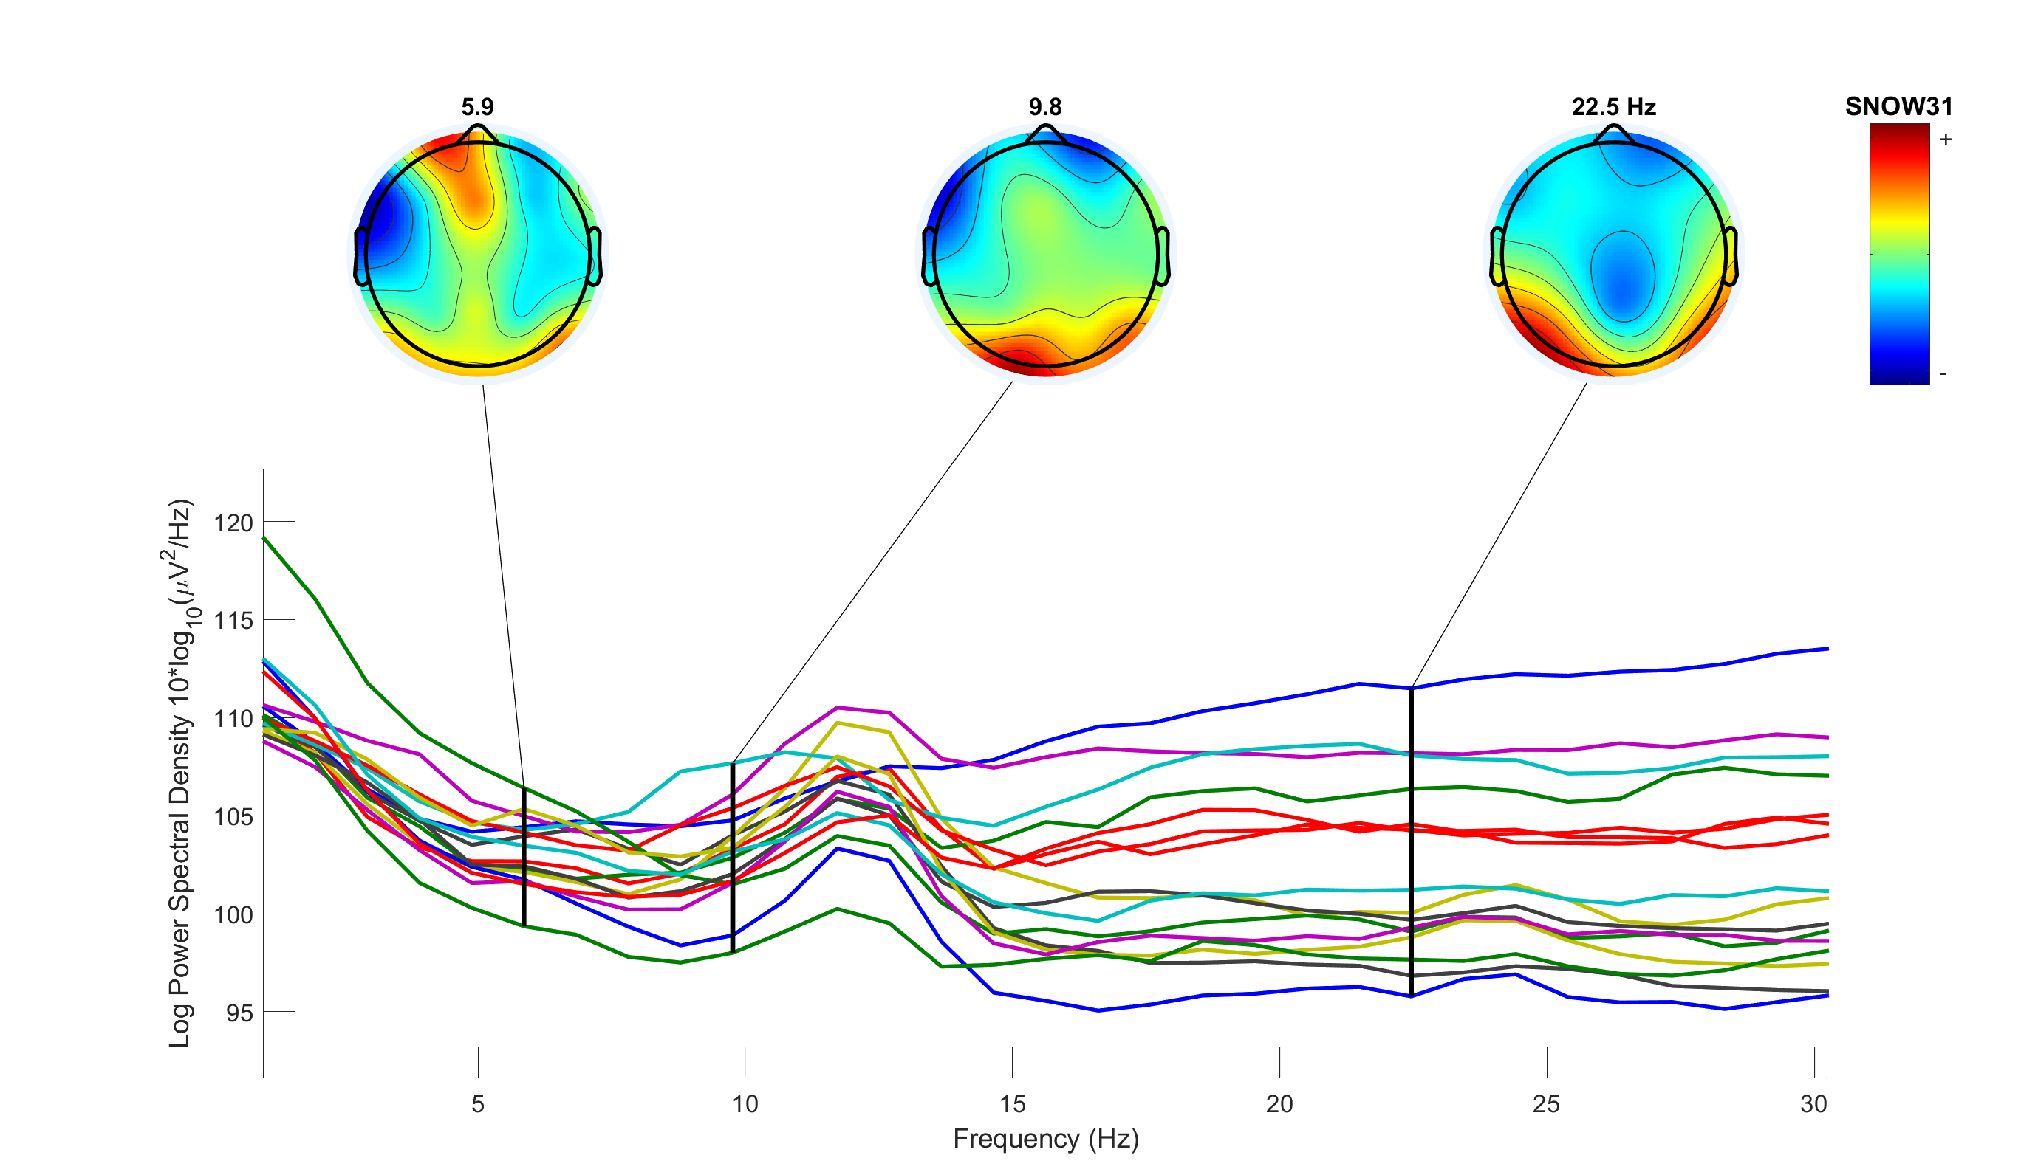
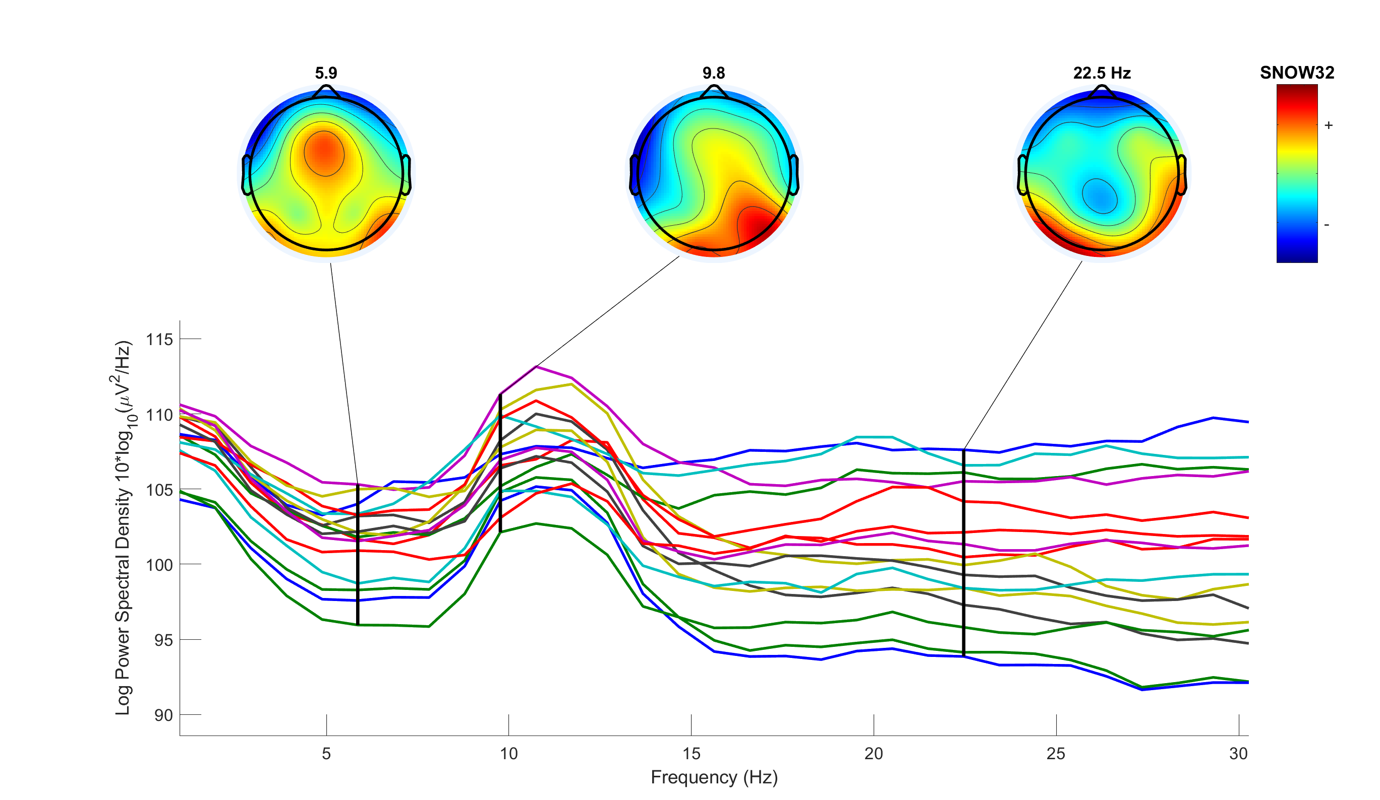
Data Analysis: PSA
Power Spectrum Analysis is a technique that applies a fast Fourier transform to the variation of a particular signal to compute its frequency spectrum
The result is presented as a plot of signal power against frequency and is referred to as its power spectrum
The power spectrum of a signal indicates the relative magnitudes of the frequency components that combine to make up the signal
Fig. 2 – An example of PSA results for different visual stimuli of Subject 3.

Slide 8
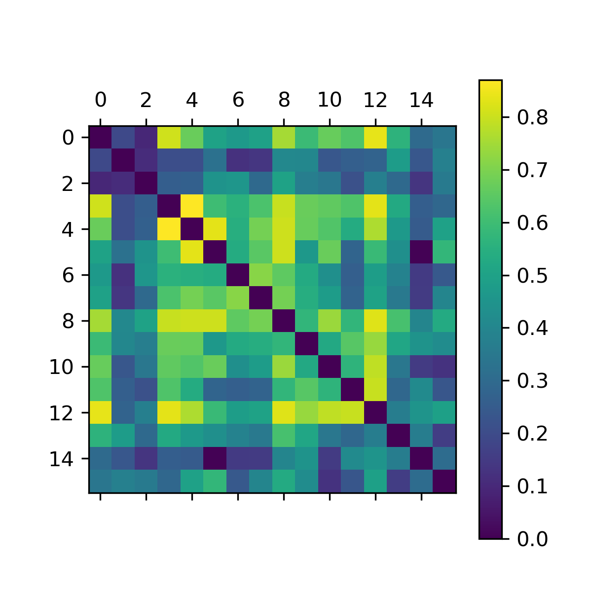
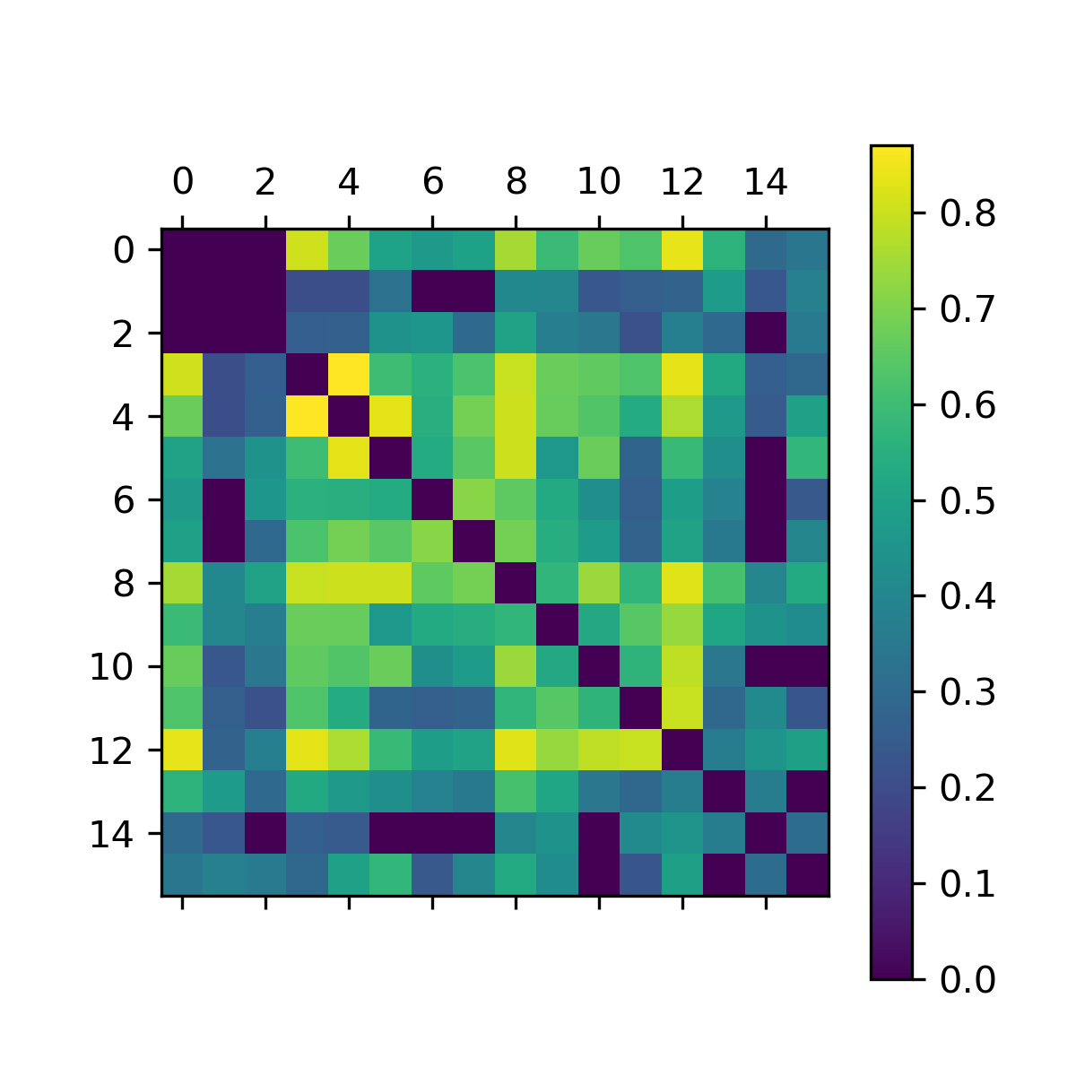
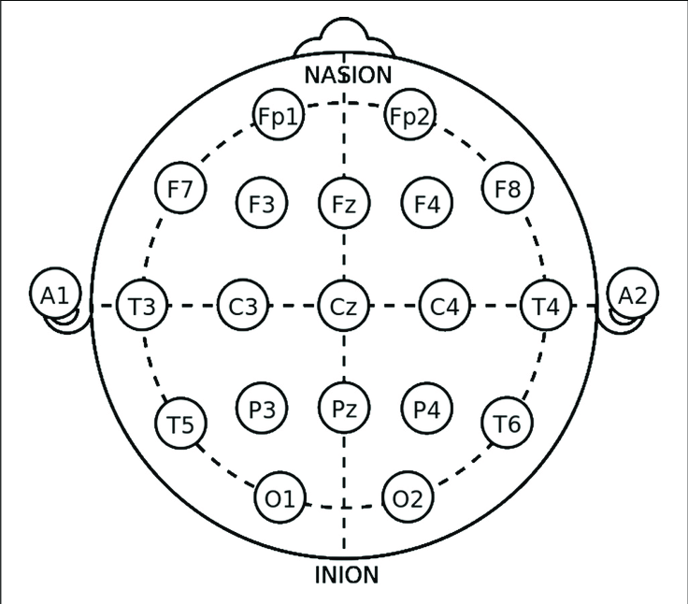
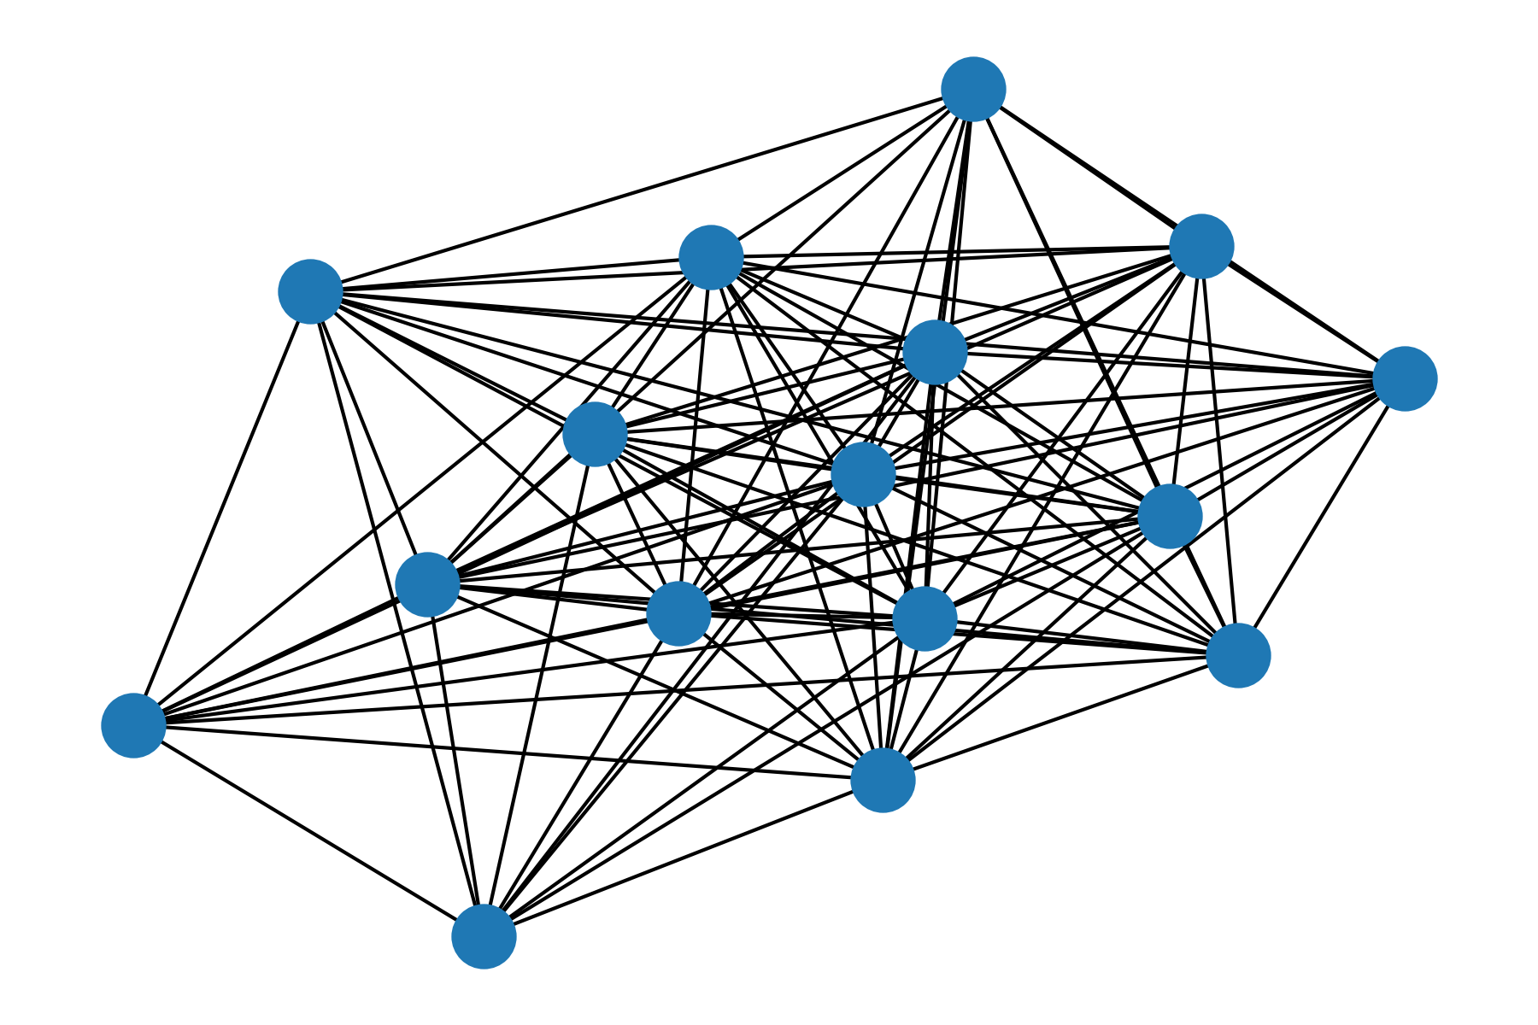
Data Analysis: Connectome
Pearson’s correlation
Threshold = 0.2
Degree
Betweenness
Edge Betweenness
Eigenvector Centrality
Local clustering coefficient
Closeness
Information

Slide 9
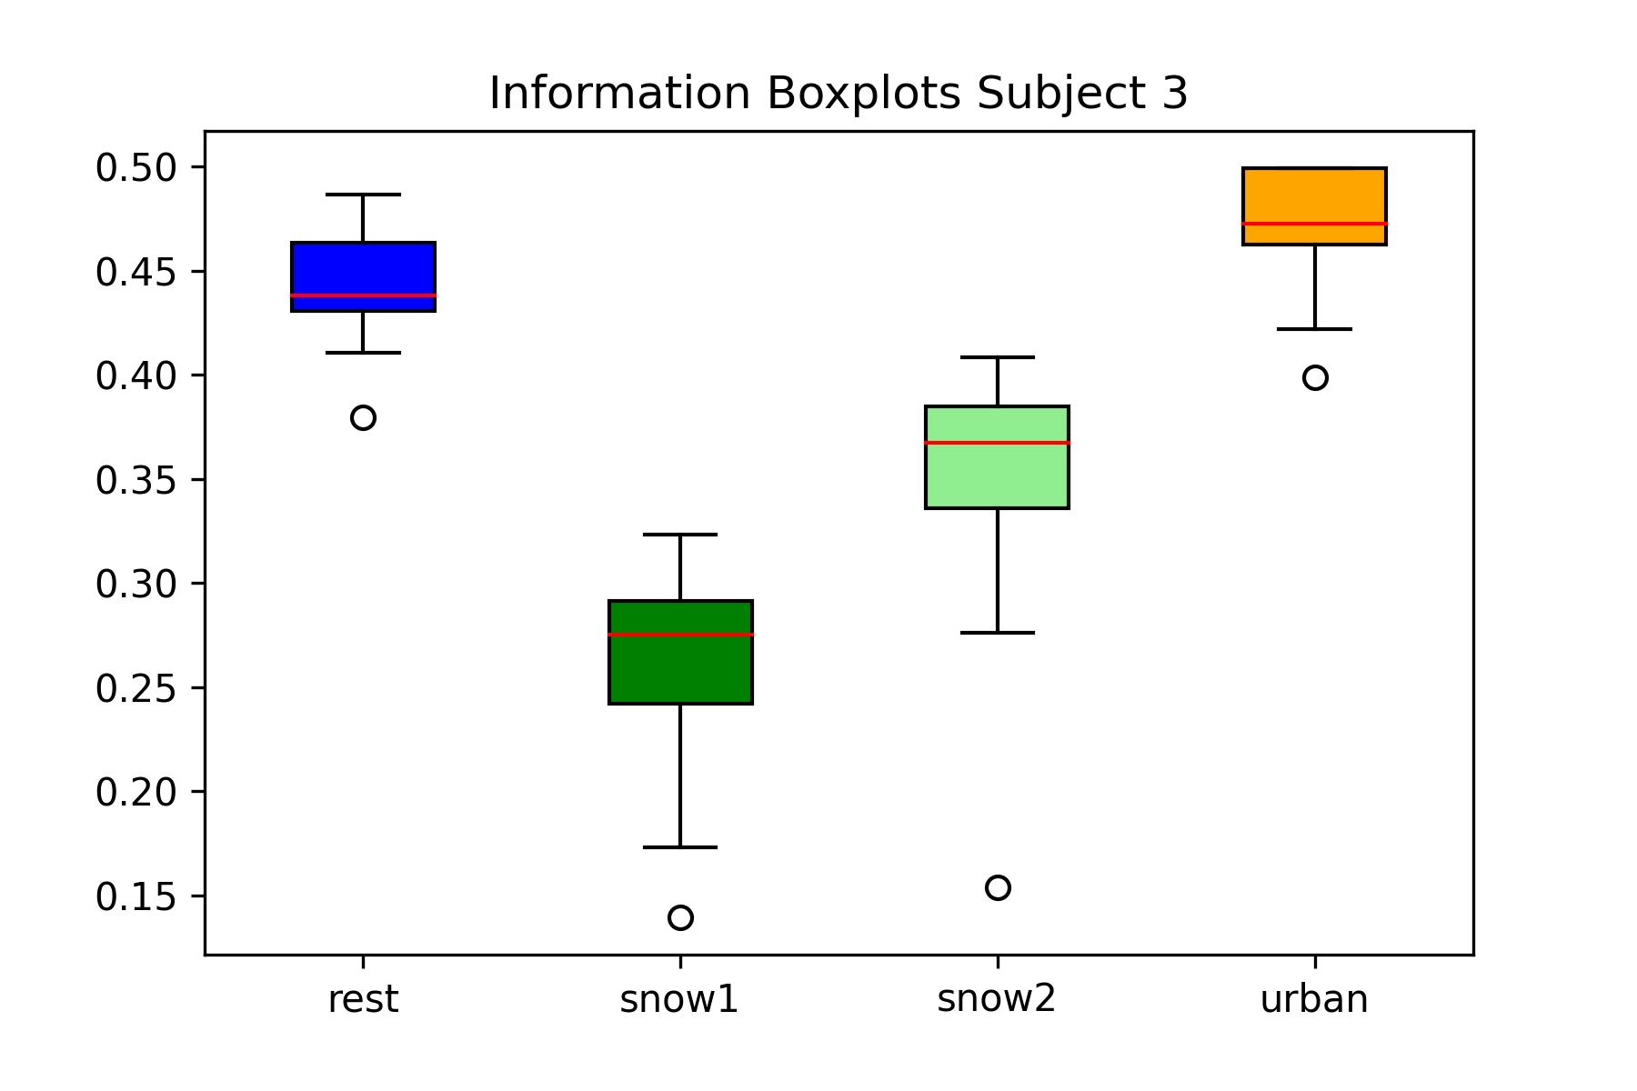
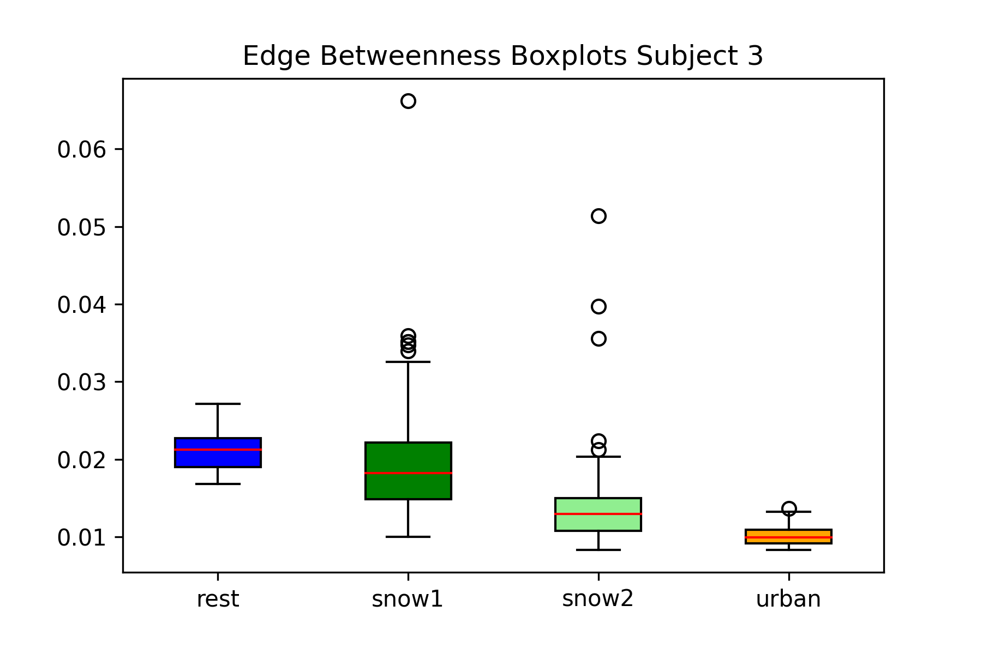
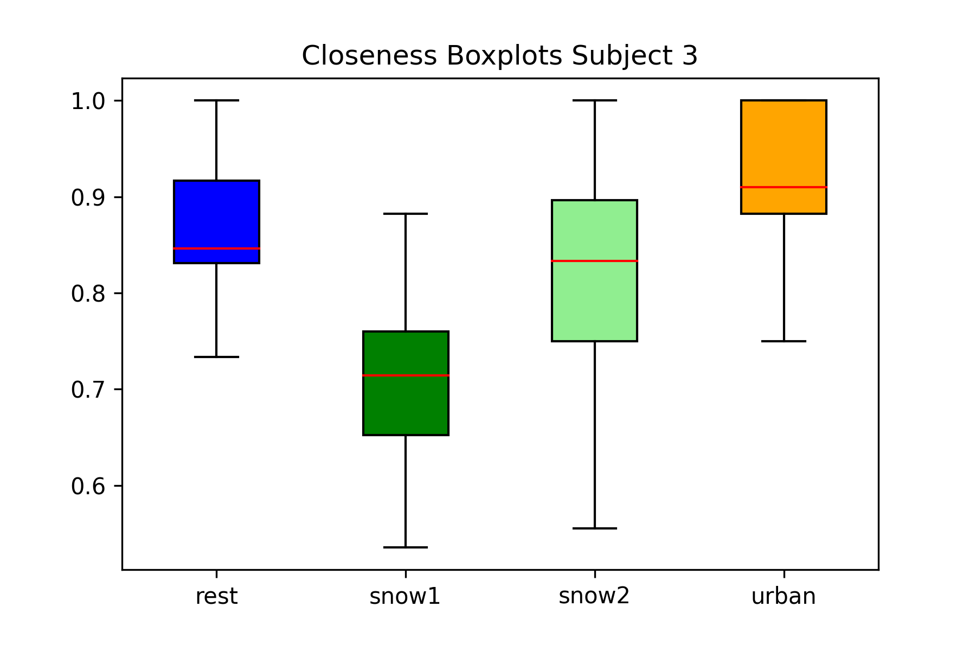
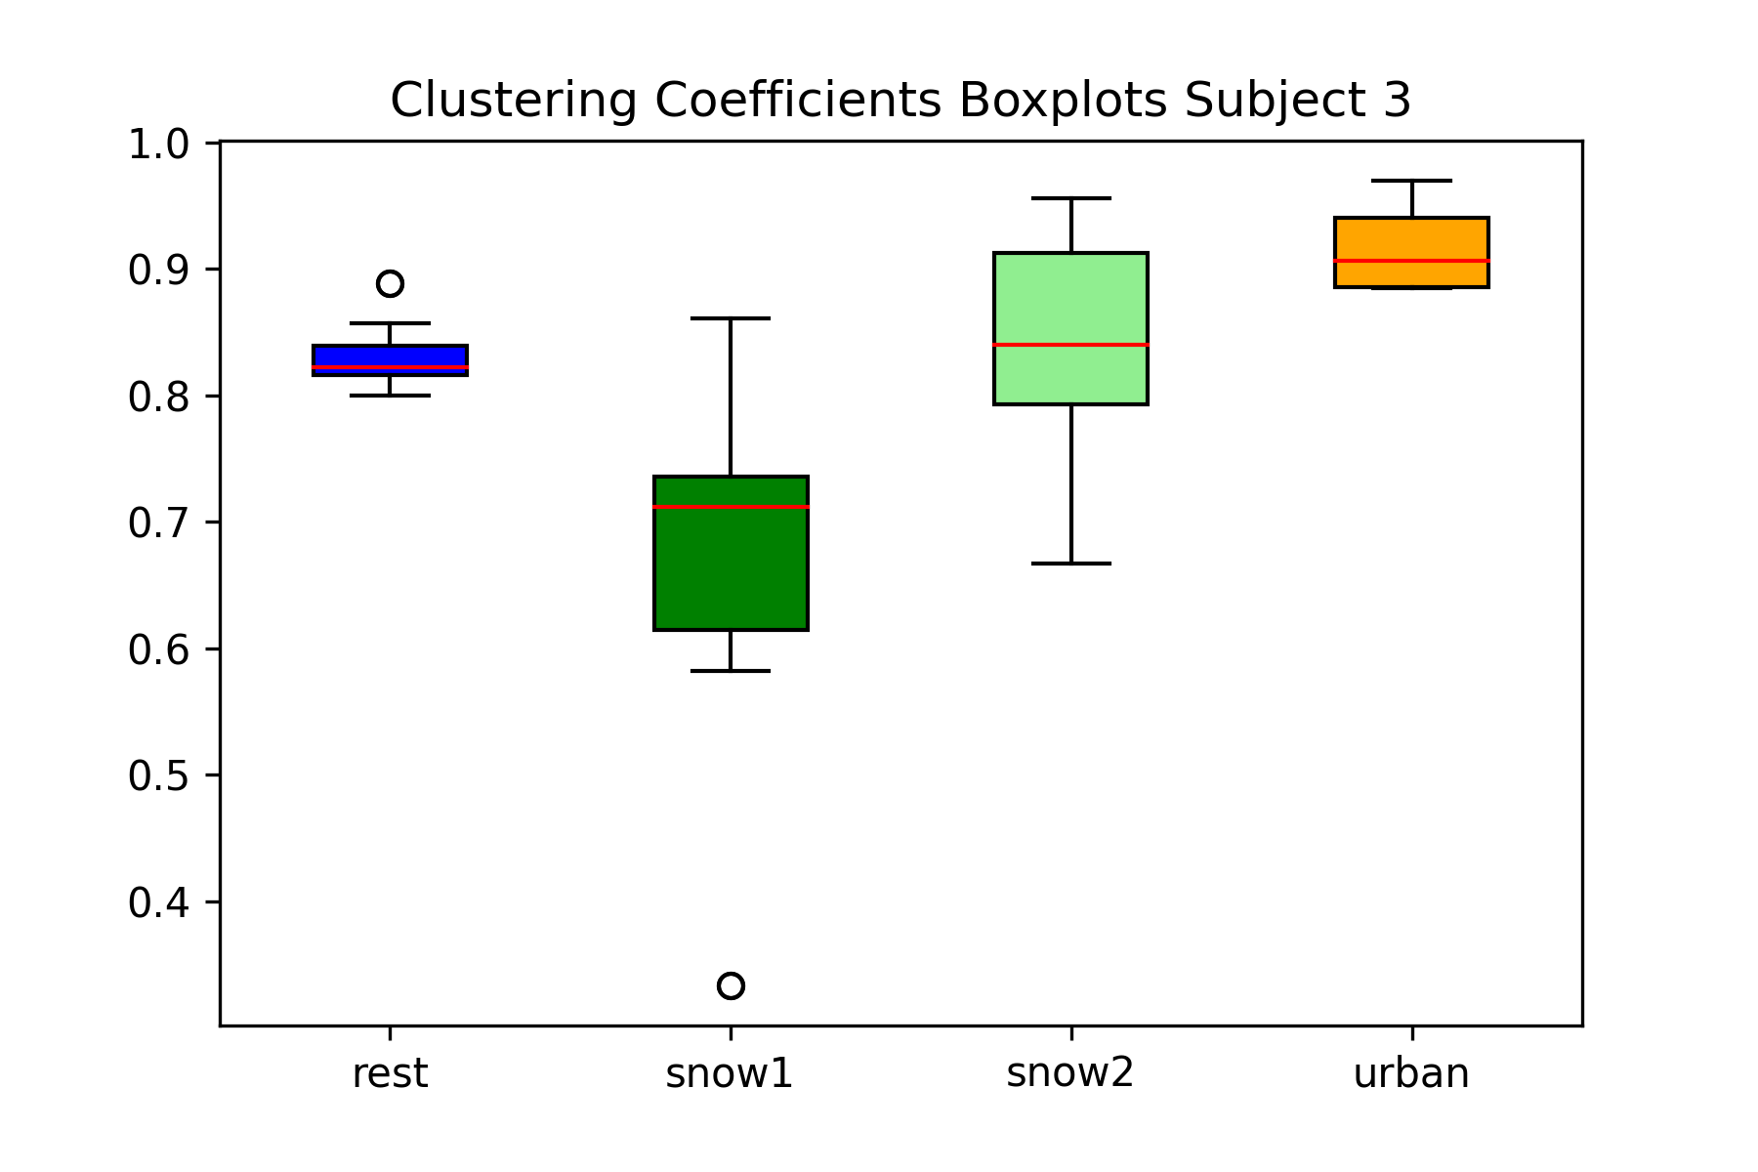
Data Analysis: Centrality Metrics
From the centrality metrics boxplots, it seems that the most discriminative metrics are:
Information
Edge Betweenness
Closeness
Local Clustering Coefficient
Fig. 3 – An example of the most informative centrality metrics for Subject 3.

Slide 10
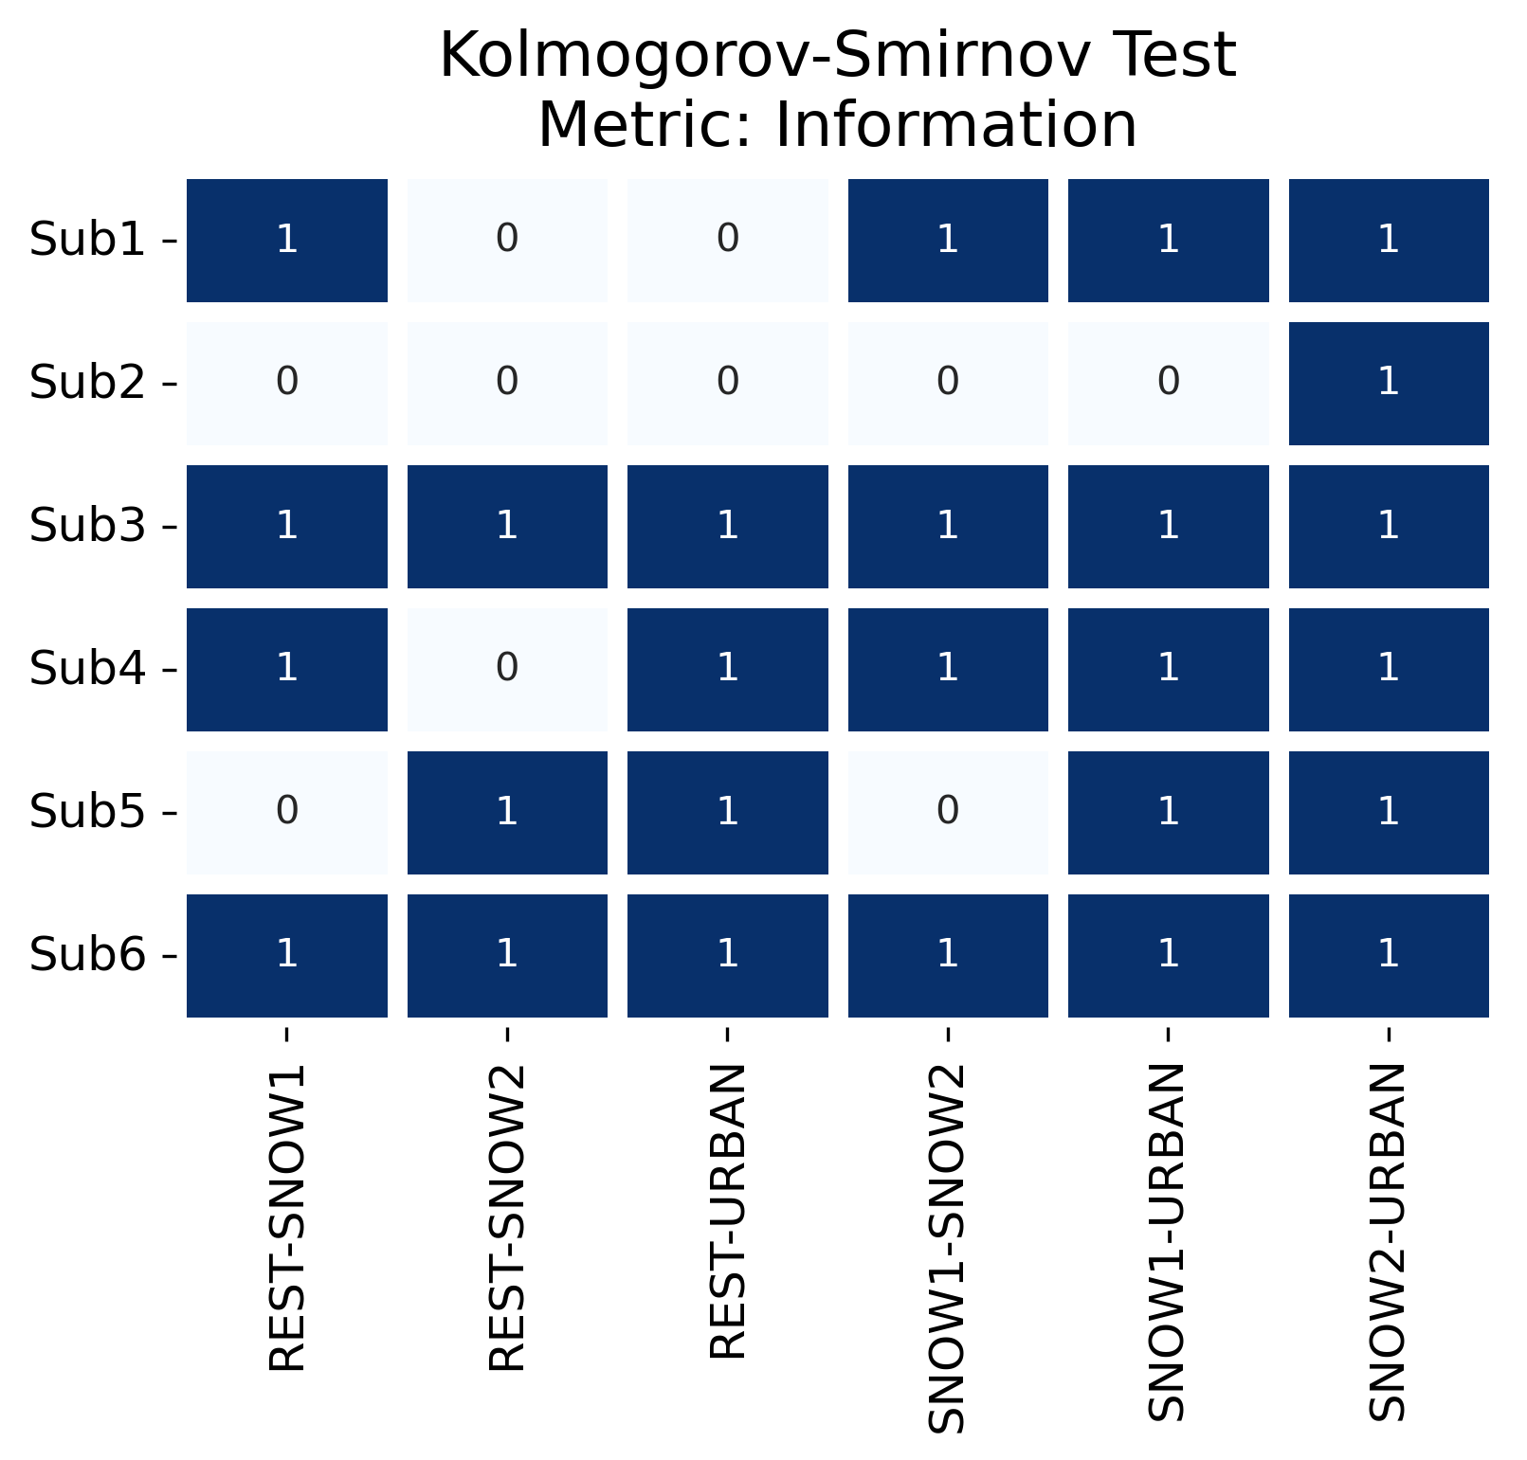
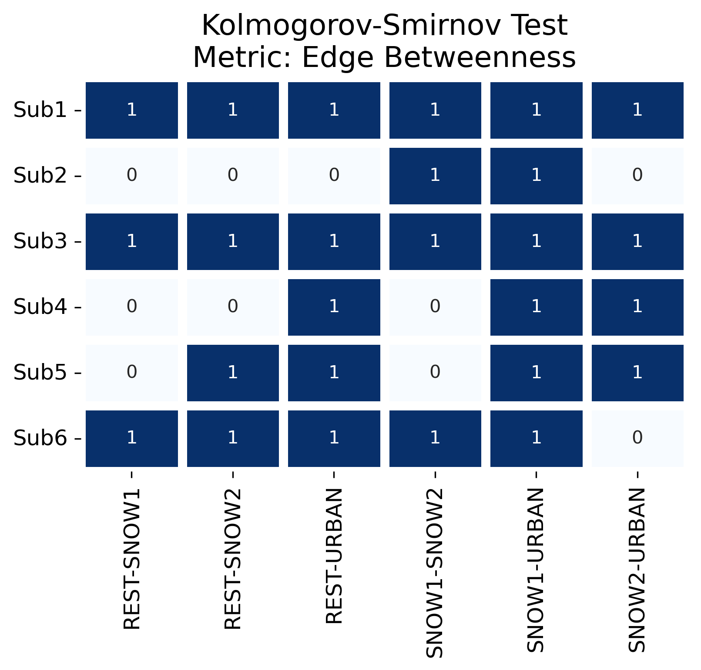
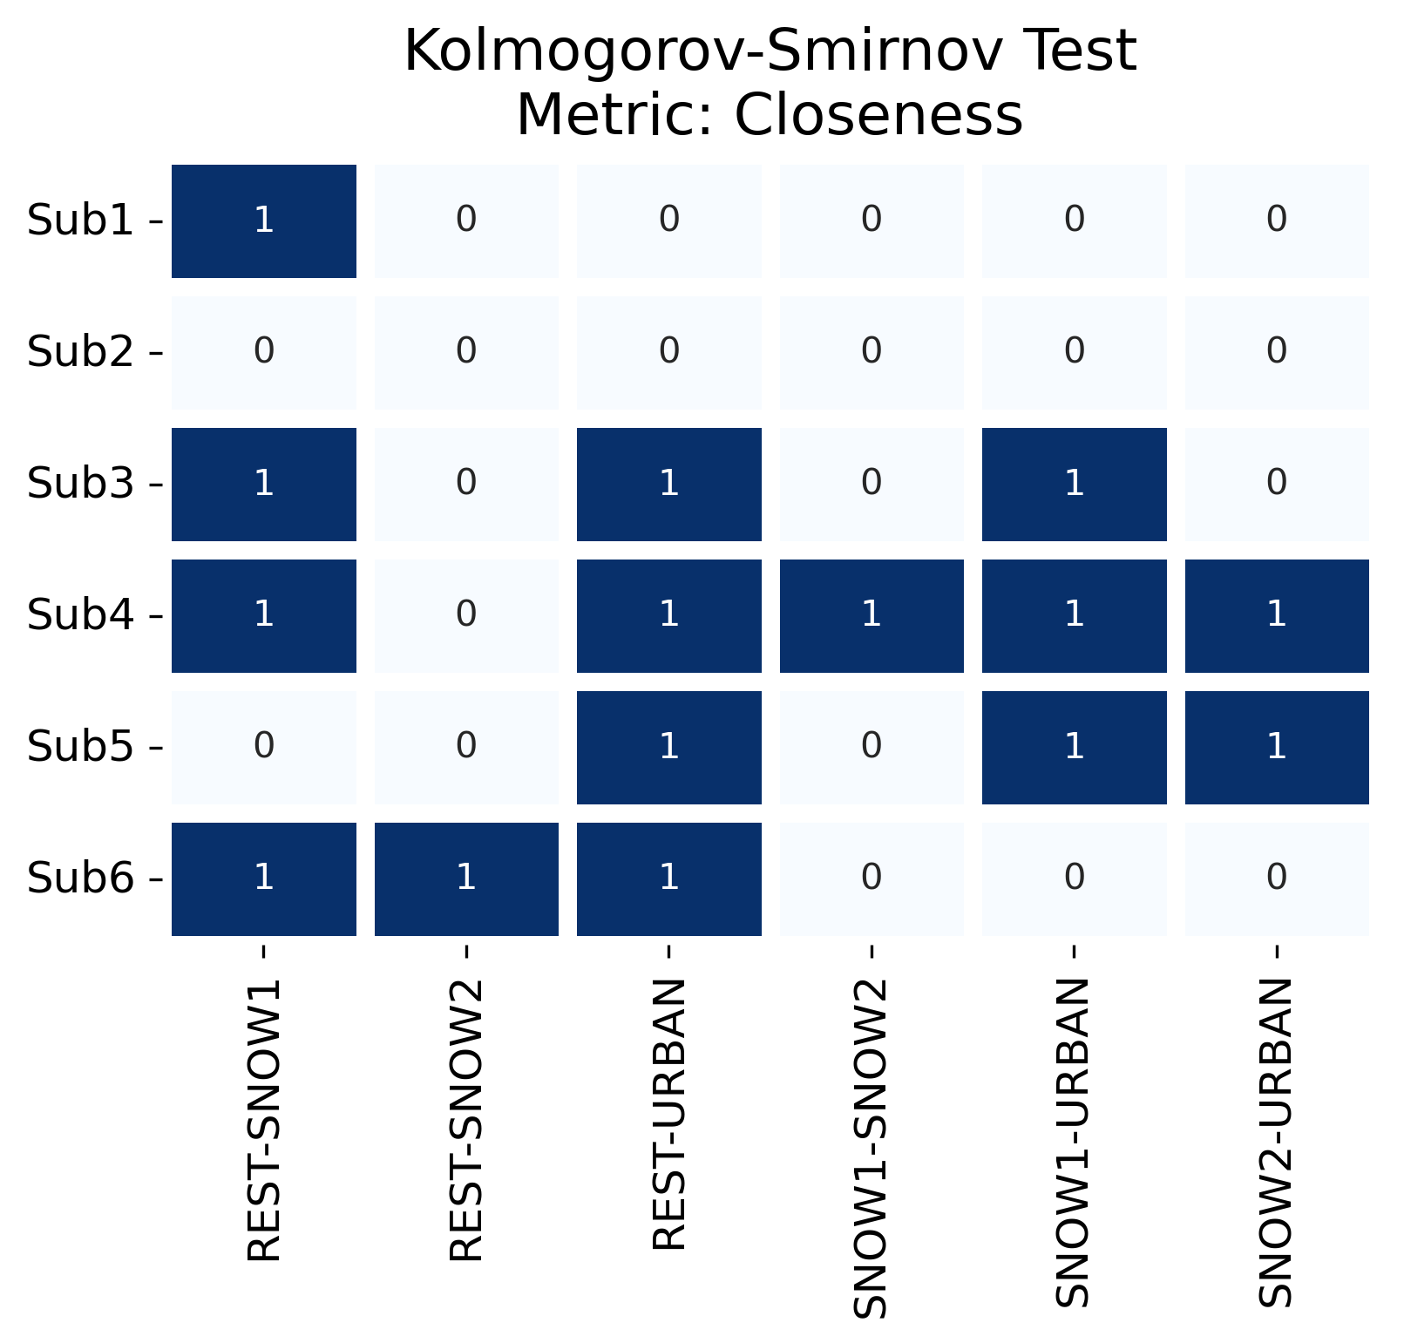
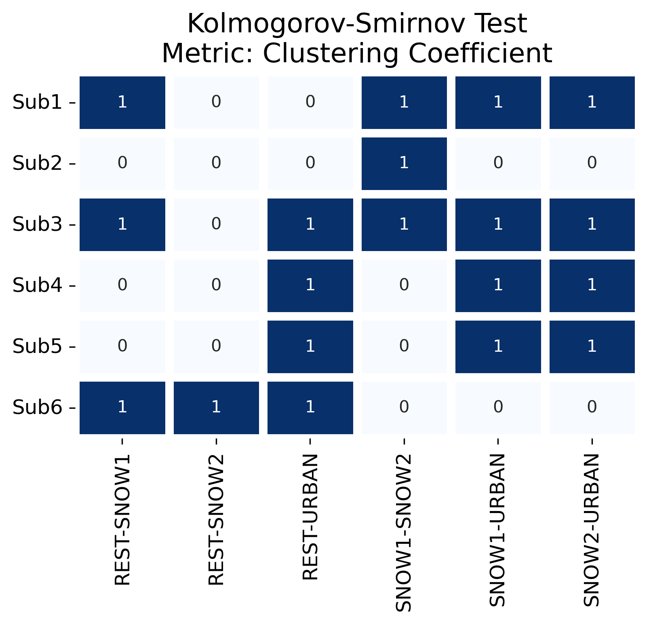
Data Analysis: Statistical Tests
To verify if there was some difference among the stimuli, the Kolmogorov -Smirnov statistical test was employed
The tests had a confidence level of 0.05: if the p-value was under the confidence level then there is a statistical difference
The statistical test was repeated between each possible pair of scenarios, fixing one subject and one graph metric at the time
1
Statistical Difference
0
No Statistical Difference

Slide 11
Results
PSA
Connectome
The “rest” phases present a similar behavior for most of the subjects, showing a peak in the region of alpha waves, in agreement with the expectations for this kind of stimulus
For the majority of the subjects, the power spectrum densities tend to become flat at higher frequencies, both for the “snow” and “urban” phases
In particular, for the “urban” phases, there aren’t any peaks in the beta frequencies range, against the expectations
From the statistical tests tables, it is possible to infer that the Local Clustering Coefficient, the Closeness and in particular the Edge Betweenness and the Information seem to distinguish among different visual stimuli
To validate this preliminar result, the analysis could be improved by widing the number of samples

Slide 12
Thanks for the attention!

